Slide 1
SMART AGRICULTURE KIT
Intruder Detection and Agriculture Information System
(INTRU-INFI-TH101)

Slide 2

PROBLEM STATEMENT
In the wake of the increasing problems faced by the farmer on and off the field related to agricultural practices such as,finding the right temperature and humidity,selecting the crop and kernel of the crop according to that temperature,protecting the field against any intruder(escpecially when the field is left unattended),we have designed a SMART AGRICULTURE KIT to pay heed and try solve these issues as much as possible.

Slide 3
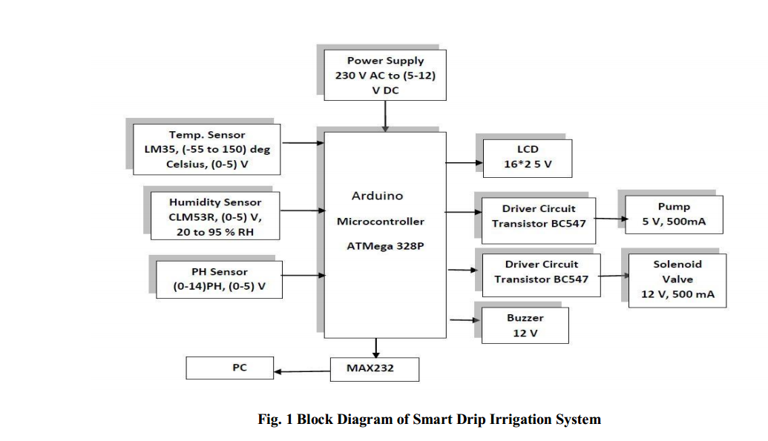
Literature Research
1.Arduino Based Smart Drip Irrigation System Using Internet of Things
G. Parameswaran1 , Department of ECE (Sri Shakthi Institute of Engg and Tech,Coimbatore, India)

Slide 4
Sensors used
A.I Sensors
There are different sensors are used to controlling the process of irrigation system. Different sensors used are
Temperature, PH, Humidity are all measured and checked with the previous data stored in a system. According to the
comparator of the system automation process of pump and solenoid valve is opened for needed.
TEMP SENSORS
Temperature range is exceeded the certain range motor started and thatrange is upto 30°C.LM35 series are precision integrated-circuit temperature sensors, whose output voltage is linearly proportional to the Celsius(temperature). It
has an advantage over linear temperature sensors calibrated in degree Kelvin, its output to obtain convenient Centigrade
scaling. It is rated to operate over a -55° to +150°C temperature range.
HUMIDITY SENSORS
Humidity is a measure in percentage, ofthe vapor in the air compared to the total amount of vapor that could be
held in the air at a given temperature of the system. SY-HS-220 is used to measure humidity in Figure 3. It operates on
DC 5 V of supply which can be easily. Its operating

Slide 5
temperature range is 0 - 60°C. The device tracts the humidity range from 30 - 90% which is more regularly find out inside the cropping land.Humidity sensor are used for measuring moisture content in the atmosphere. It rely on measurements of temperature, pressure, mass etc. There are different sensors avail are capacitive, resistive, thermal, gravimetric.
PH Sensors
are used to measure the nutrient content in the soil required for irrigation. The other thing is that
correct amount of nutrient is supplied to the soil.

Slide 6
OBJECTIVE OF INTRU-INFI-TH101
INTRU-INFI-TH101aims to:-
1.Detect the presence of a person other than the farmer on the farm land and raise an alarm (not by the conventional method of buzzer or video capture) by sending an immediate message to the farmer’s cellphone with the message “Someone just entered the Farm”.
2.It will also have a temperature and humidity detection system which will help identify what is the suitable temperature for wheat and wheat kernel as well poultry farm birds like broilers and layer birds to breed,thus sending a pertinent message to the farmer’s mobile.

Slide 7
What’s New?
1.The first major difference if that the farmer doesn’t have to wait for a buzzer to go on to detect an intruder.
2.A database has been used to store the information of temperature and humidity collected from the farm which will be later sent to the account of the farmer via GMAIL , as part of implementation under the CLOUD because we aim to increase the accessibility of the nformation so that the farmer is able to have access to it anywhere,anytime.

Slide 8
Why raspberry pi?
The Raspberry Pi 3, with a quad-core Cortex-A53 processor, is described as 10 times the performance of a Raspberry Pi 1.^{[19]} This was suggested to be highly dependent upon task threading and instruction set use. Benchmarks showed the Raspberry Pi 3 to be approximately 80% faster than the Raspberry Pi 2 in parallelized tasks.^{[20]}
Raspberry Pi 2 includes a quad-core Cortex-A7 CPU running at 900 MHz and 1 GB RAM. It is described as 4–6 times more powerful than its predecessor. The GPU is identical to the original.^{[18]} In parallelized benchmarks, the Raspberry Pi 2 could be up to 14 times faster than a Raspberry Pi 1 Model B+.^{[21]}
While operating at 700 MHz by default, the first generation Raspberry Pi provided a real-world performance roughly equivalent to 0.041 GFLOPS.^{[22][23]} On theCPU level the performance is similar to a 300 MHz Pentium II of 1997–99. The GPU provides 1 Gpixel/s or 1.5 Gtexel/s of graphics processing or 24 GFLOPS of general purpose computing performance. The graphical capabilities of the Raspberry Pi are roughly equivalent to the performance of the Xbox of 2001.
The LINPACK single node compute benchmark results in a mean single precision performance of 0.065 GFLOPS and a mean double precision performance of 0.041 GFLOPS for one Raspberry Pi Model-B board.^{[24]} A cluster of 64 Raspberry Pi Model B computers, labeled "Iridis-pi", achieved a LINPACK HPL suite result of 1.14 GFLOPS (n=10240) at 216 watts for c. US$4000.[

Slide 9
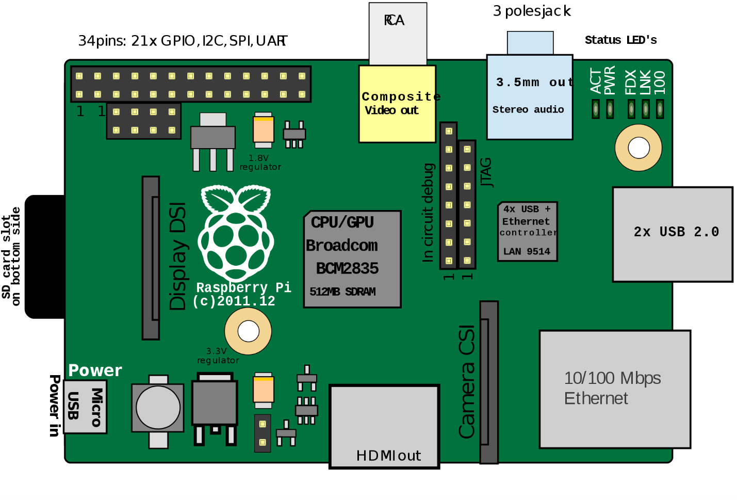

Slide 10
Uses
Use in home automation
There are a number of developers and applications that are leveraging the Raspberry Pi for home automation. These programmers are making an effort to modify the Raspberry Pi into a cost-affordable solution in energy monitoring and power consumption. Because of the relatively low cost of the Raspberry Pi, this has become a popular and economical solution to the more expensive commercial alternatives.^{[182]}
Use in industrial automation
In June 2014, TECHBASE, Polish industrial automation manufacturer designed world's first industrial computer based on Rapberry Pi Compute Module, called ModBerry. The device has numerous interfaces, most notably RS-485/232 serial ports, digital and analog inputs/outputs, CAN and economical 1-Wire buses, all of which are widely used in automation industry. The design allows the use of Compute Module in harsh industrial environments, leading to conclusion, that Raspberry Pi is no longer limited to home and science projects only, but can be widely used as Industrial IoT solution and achieve goals of Industry 4.0.^{[183]}
Use in commercial products
OTTO is a digital camera created by Next Thing Co. It incorporates a Raspberry Pi Compute Module. It was successfully crowd-funded in a May 2014 Kickstarter campaign.^{[184]}
Slice is a digital media player which also uses a Compute Module as its heart. It was crowd-funded in an August 2014 Kickstarter campaign. The software running on Slice is based on Kodi.^{[185]}

Slide 11
1.DHT11(TEMP AND HUM SENSOR)
DESCRIPTION
The DHT11 is a basic, ultra low-cost digital temperature and humidity sensor. It uses a capacitive humidity sensor and a thermistor to measure the surrounding air, and spits out a digital signal on the data pin (no analog input pins needed). Its fairly simple to use, but requires careful timing to grab data. The only real downside of this sensor is you can only get new data from it once every 2 seconds, so when using our library, sensor readings can be up to 2 seconds old.

Slide 12
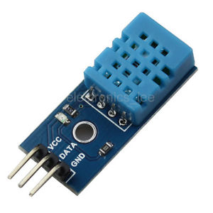
TECHNICAL DETAILS
Low cost
3 to 5V power and I/O
2.5mA max current use during conversion (while requesting data)
Good for 20-80% humidity readings with 5% accuracy
Good for 0-50°C temperature readings ±2°C accuracy
No more than 1 Hz sampling rate (once every second)
Body size 15.5mm x 12mm x 5.5mm
4 pins with 0.1" spacing

Slide 13
2.GSM MODULE 900A
Product Details
- Compatible with ARDUINO, RASPBERRY PI, ARM, AVR, PIC, 8051, etc.
- Can be directly connected to computer via Serial Port (Use GSM Tester or write your own Software)
- Best suited for GSM based Microcontroller Projects (better than SIM300 and other GSM Modems)
- Option for connecting MIC and SPEAKER directly to GSM MODEM for calls (LINE IN also available)
- Supports communication through RS232 with DB9 Connector, TTL Pins & I2C Pins
- Compatible with AC / DC Adapter (AC & DC solder points also available on board)
- ON/OFF Switch for easy switch ON after inserting SIM (or keep in ON position for auto ON on powering)
- DEBUGGER Pins available

Slide 14
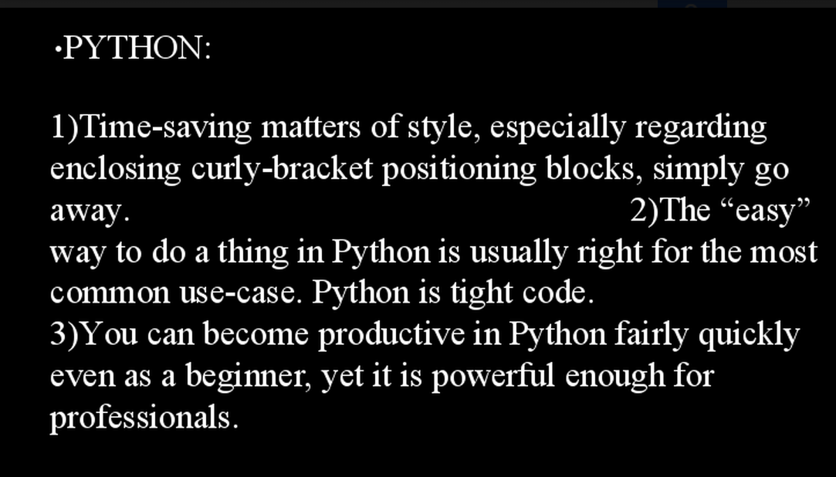

Slide 15
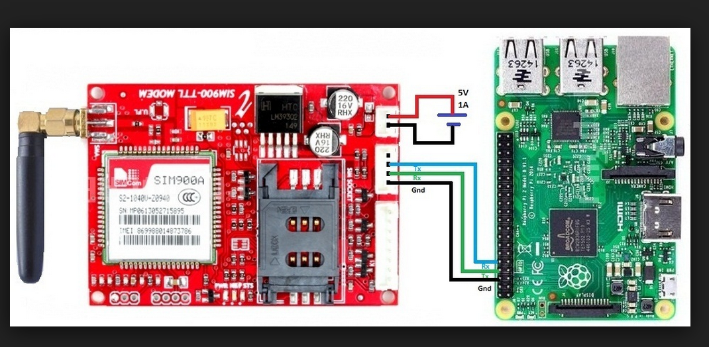
INTERFACING THE GSM

Slide 16
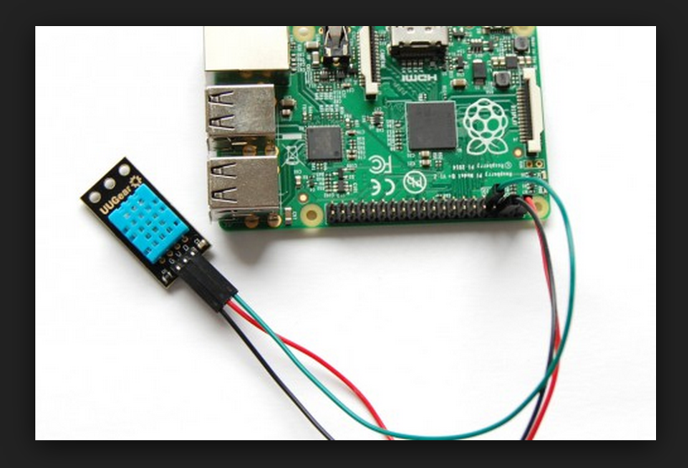
INTERFACING THE DHT11

Slide 17
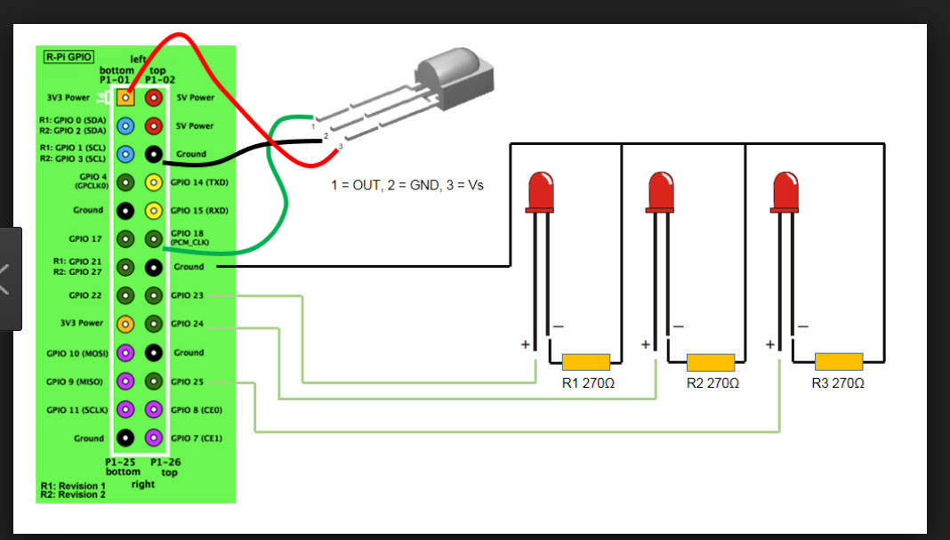
INTERFACING IR WITH CHIP

Slide 18
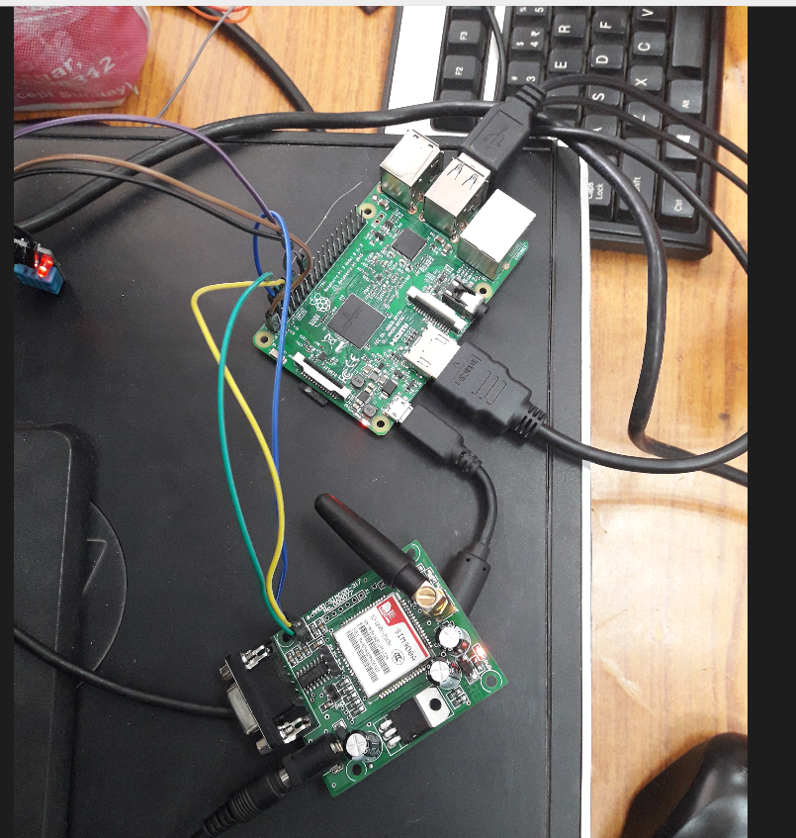
SNAPSHOTS

Slide 19
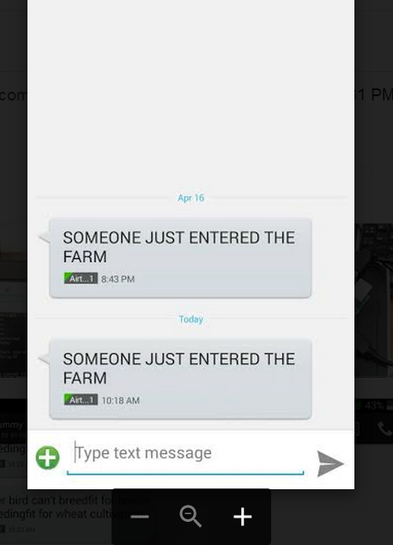
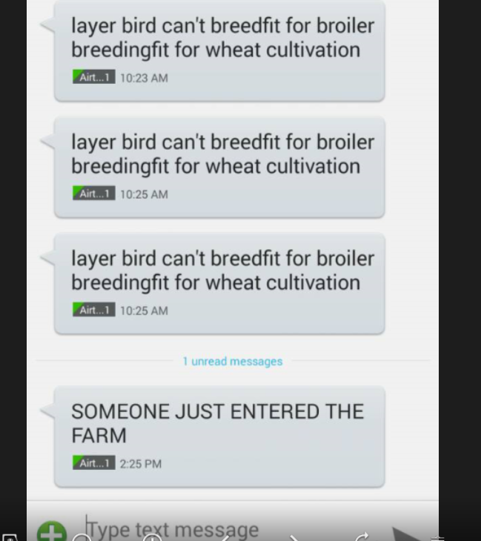

Slide 20
File handling in raspberry pi
There are two types of file: text and binary. The interpretation of text files differs between systems to match their internal ways of working with text, with special byte values for characters such as carriage return, line feed and end of file. Binary files are simply an array of bytes and are always written and read the same regardless of the type of system. The only issue that can occur is moving files between little endian and big endian systems where if a file has been specified using variables bigger than a byte (e.g. storing int values) the different endian systems will read and write the bytes of larger values in opposite order. This issue is avoided by always specifying the layout of files in bytes and where larger variables are stored specifying the byte order in which they are stored

Slide 21
Why use files in project intru-infi-th101
The farmer tends to take certain wrong decisions of temperature and humidity more often than not ,because of lack of old knowledge.
A table with previously recorded temp and hum will help refer this at any time from anywhere to make right decisions for the farm!

Slide 22
references
[1] Z. Sundas, “Motion Detecting Camera Security System with Email Notifications and Live Streaming Using Raspberry Pi.” .
[2] M. Peter and H. David, “Learn Raspberry Pi with Linux,” Apress, 2012
. [3] P. S. Dhake and B. Sumedha S., “Embedded Surveillance System Using PIR Sensor.,” vol. No. 02, no. 3, 2014.
[4] J. D., “Real Time Embedded Network Video Capture And SMS Alerting system,” Jun. 2014. [5] S. Sneha, “IP Camera Video Surveillance using Raspberry Pi.,” Feb. 2015.
[6] F. C. Mahima and A. Prof. Gharge, “Design and Develop Real Time Video Surveillance System Based on Embedded Web Server Raspberry PI B+ Board. International Journal of Advance Engineering and Research Development (Ijaerd), NCRRET.,” pp. 1–4, 2015.
[7] J. G. J, “Design and Implementation of Advanced ARM Based Surveillance System Using Wireless Communication.,” 2014.

Slide 23
[8] P. Sanjana, J. S. Clement, and S. R., “Smart Surveillance Monitoring System Using Raspberry PI and PIR Sensor.,” 2014. [9] U. Kumar, R. Manda, S. Sai, and A. Pammi, “Implementation Of Low Cost Wireless Image Acquisition And Transfer To Web Client Using Raspberry Pi For Remote Monitoring. International Journal of Computer Networking, Wireless and Mobile Communications (IJCNWMC).,” vol. No. 4, no. 3, pp. 17–20, 2014. [10] “The History of Security _ PerspecSys.com.htm.” . [11] A.-D. Osama, “Cisco IP Video Surveillance Introduction,” Cisco Expo, 2009. [12] “What is a security system and how does it work _ SafeWise.htm.” . [13] T.K. Hareendran, “GSM Home Security Alarm System With Arduino,” Library Security System, 2014. . [14] R. Verman, “Distance Education In Technological Age,” Anmol Publ. Pvt Ltd, p. 166, 2005. [15] “Television Rides Wires,” Pop. Sci., no. February, p. 179, 1949. [16] “Introduction to Closed Circuit Television,” Jan-2013. . [17] B. Messauod, Access Control Systems: Secuiry, Management and Trust Models., 1st ed. Austin, TX, USA: Springer, 2006. [18] “IP Surveillance,” IT Encyclopedia. . [19] “ijcsit2014050648.pdf.” . [20] B. E. Reddy, M. Veeresha, and N. Rao, “Image Processing: A Survey.”

Slide 24
[21] A. Ambrosetti and P. H. Rabinowitz, “Dual variational methods in critical point theory and applications,” J. Funct. Anal., vol. 14, no. 4, pp. 349–381, 1973 [22] “113-115-OBJECT-DETECTION-AND-TRACKING-USING-IMAGEPROCESSING.pdf.” . [23] “Simon_Denman_Thesis.pdf.” . [24] S. Prasad, P. Mahalakshmi, A. J. C. Sunder, and R. Swathi, “Smart Surveillance Monitoring System Using Raspberry PI and PIR Sensor,” Int. J. Comput. Sci. Inf. Tech., vol. 5, no. 6, 2014. [25] Raspberry Pi for Begginers, 2014th ed. London UK.: Imagine Pulishing Ltd. 35 [26] B. J. Glenn, Computer Science: An Overview, 11th ed. Edwards Brothers. [27] “The Raspberry Pi Education Manual,” Dec. 2012. [28] “How Infrared Motion Detector Components Work,” Glolab Corporation., 2013. [29] “pir-passive-infrared-proximity-motion-sensor.pdf.” . [30] G. Honey, Intruder alarms, 2nd ed. Oxford ; Burlington, MA: Newnes, 2003. [31] “The Raspberry Pi Education Manual,” no. 1.0, Dec. 2012.

